Slide 1
iOS Best Practices: Avoid the Bloat
Twitter: @JAgostoni
http://jason.agostoni.net
http://bit.ly/SportsApp

Slide 2
Jason Agostoni
Sr. Software Architect at CEI
Lead for Integration and Mobile Areas
14+ Years in Microsoft and Mobile Platforms
Apps in the App Store:
Pittsburgh Code Camp
Sports Schedules (give me a good review?)
http://bit.ly/SportsApp
Several clients’ apps
Clients of all sizes

Slide 3
Challenges
We have learned to apply best practices and design patterns for RIA/Rich/Web apps
Why is mobile different?
Symptom of learning on-the-side?
Feeling that it doesn’t matter?
Less experienced developers?
It may be even more important to apply best practices in mobile development

Slide 4

Do you believe in best practices and design patterns?
Notes:
Image courtesy Thad Zajdowicz

Slide 5
Rationale: Best Practices
Avoid common mistakes
Consistency
Security
Maintainability
Etc.
WE ALL KNOW ABOUT BEST PRACTICES IN SOFTWARE DEVELOPMENT: WHY DO WE SEE THEM ONLY IN POWER POINT PRESENTATIONS? – Prakash J

Slide 6
Rationale: Design Patterns
Most problems have already been solved
Easy to recognize by developers
Nearly all frameworks embrace patterns
Tested over and over again
Not just reusable code but reusable ideas
Reduce implementation time

Slide 7

Big Ball Of Mud
Very common anti-pattern in Objective-C
Makes code un-maintainable
High code risk
Insecure
Ugly
Notes:
Image Courtesy Linden Laserna

Slide 8
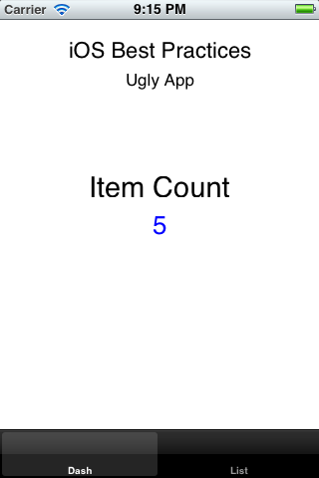
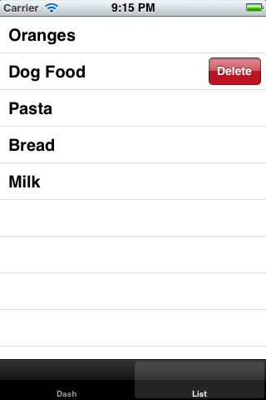
The Ugly App
It ain’t pretty
It has lots of problems
It’s unmaintainable
It’s fragile
It’s full of risk
Worst yet: It’s not atypical
It can’t be that bad … can it?

Slide 9
Complexity Indicators
More than one protocol in a class
Large number of properties (not a model)
Direct references between views/controllers
Lots … and lots … of scrolling
Long list of #import statements
Really long-winded methods

Slide 10
Problem #1: Responsibilities
AppDelegate has TOO many responsibilities
Holds a reference to the Data Model
Responsible for loading the data model
Responsible for parsing the XML
Responsible for being the AppDelegate
Each class has to reference the delegate and has control over the data source (NSMutableArray) and can corrupt it

Slide 11
Solution: Two Patterns
Singleton
Single-Responsibility Principle
Encapsulate control, lifetime, scope, creation of an object
Ensure only one copy of an object exists
Perfect replacement for “global variables” in the App Delegate
Ugly App: the data source
Any class should have at most ONE purpose
A class should completely encapsulate that purpose
A class should have only one “reason to change”
Cohesiveness
Ugly App: Split the XML parsing from the data model

Slide 12
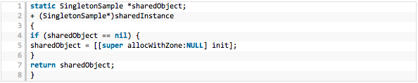
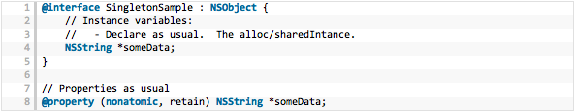

Singleton in Objective-C
Shared Manager
Instance Variables
Convenience Methods

Slide 13

FIX #1: Split out the data and xml responsibilities

Slide 14
Problem #2: Class Coupling
Too many classes have direct references
All classes rely on AppDelegate making: changes are HIGH impact
Different views/ViewControllers refer to each other (BAD)
Change is DIFFICULT
List View / Controller
Dash View / Controller
AppDelegate
Model
XML

Slide 15
Solution: Observer Pattern
Model updates are coordinated through events bubbled to concerned views
“Publisher” pushes event to a central framework – publish/subscribe
“Observers” listen for specific events to take action, data are frequently packaged in event
No direct coupling is necessary between publishers and observers

Slide 16
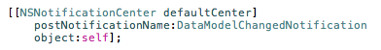
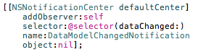
Observer in Objective-C
NSNotificationCenter
Broadcast between objects within an application
Each NSNotification as a name, sender and info dictionary
Observers use the addObserver method to route notifications to a given method/selector
By default, notifications are routed synchronously

Slide 17
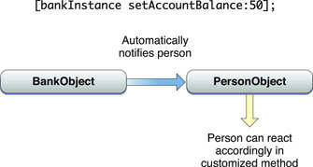
Observer in Objective-C
Key-Value Observing
Observers are automatically notified when a property changes on an object
Subject must be “KVO” compliant
Subject can be single object or collection
http://developer.apple.com/library/mac/#documentation/cocoa/Conceptual/KeyValueObserving/KeyValueObserving.html

Slide 18

FIX #2: decouple the views using an observer pattern
Notes:
Image Courtesy g-point

Slide 19
Improvements
Using these design patterns:
The application is more maintainable
Code risk is greatly reduced
The code is easy to follow and understand
There is less impact to change
Other Developers will appreciate it
The code is intuitive
The design patterns are recognizable

Slide 20
Built-in Design Patterns
Model View Controller
Presentation pattern native within CocoaTouch
Category
Provides ability to extend functionality of a class without subclassing
Delegation (Protocols)
Same as interfaces in other languages
Proxy (NSProxy)
Stand-in object which forwards calls to another object
Factory
Object which creates other objects
Interesting in Objective-C where the Classes themselves have factories

Slide 21
Resources
Books
Cocoa Design Patterns Buck, Yacktman Addison Wesley
Pro Objective-C Design Patterns Carlo Chung Apress
Online
My Blog http://jason.agostoni.net
Objective-C Design Patterns http://www.informit.com/articles/article.aspx?p=1566875
Wikipedia
Has some good examples in the general design pattern pages

Slide 22

Thanks!
Twitter: @JAgostoni
Blog: http://jason.agostoni.net
Sports Schedules: http://bit.ly/SportsApp
Code samples: https://github.com/JAgostoni/iOS-Best-Practices

